Slide 1
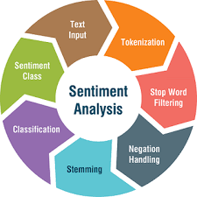
P- GROUP-3
FINANCIAL SENTIMENT ANALYSIS
Presented By: -
Mr. Zambare Linay Prashant
Mr. Manish Shantaram Mohite
Mr. Pratik Vilas Thete
Mr. Yash Ramchandra Bhosale
Mr. Ponugupati Venkata Sai Avinash
Miss. Sanjiwani Wadhave
Mr. Yash Chandrashekhar Wani

Slide 2
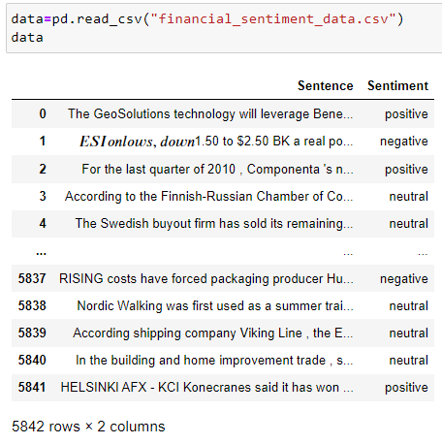
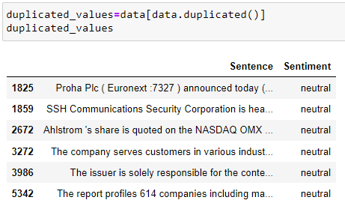
Data Set
Duplicate Data

Slide 3
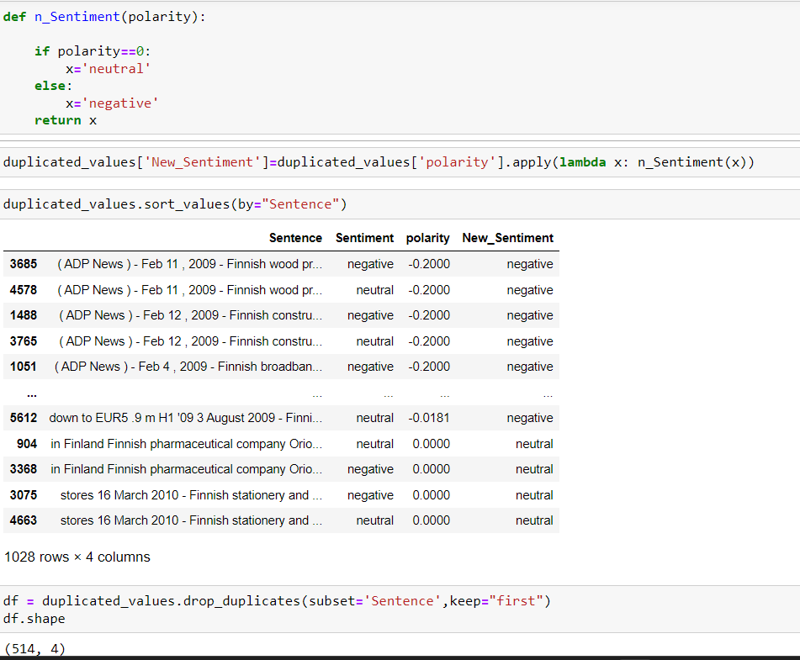

Slide 4
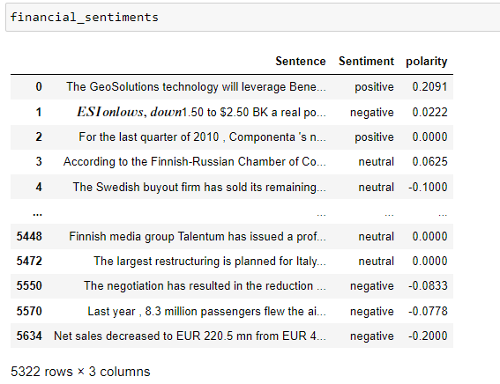
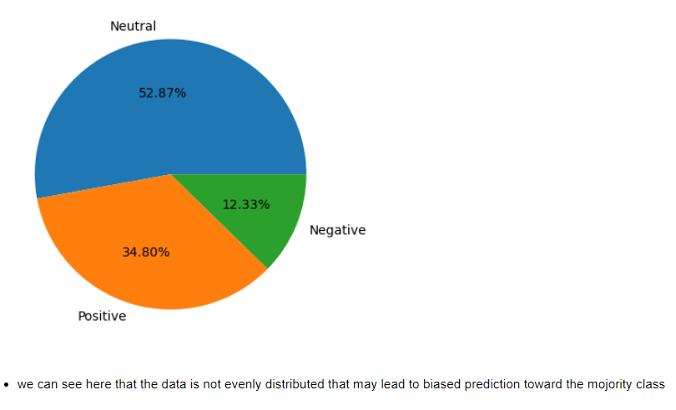
Distribution of Sentiment

Slide 5
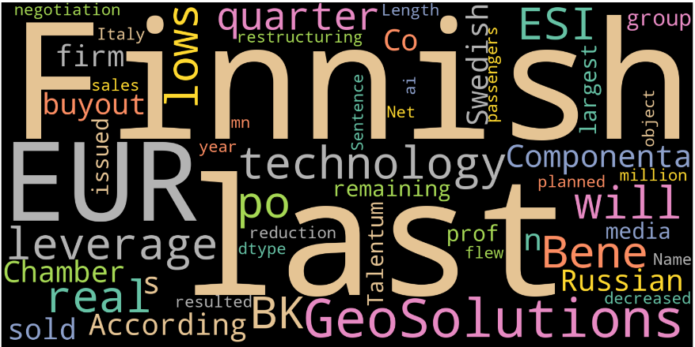
By viewing the wordcloud and the dataset we can see the there are many links found in the text
many currency names found in the sentences which does not influence the text
many years and share values are reported comparing its previous years reports which cannot be used in sentiment analysis
many measurements are found along with their units which do not contribute to the sentiments
there are many organization names and country names which cannot influence sentiments
hence there are many symbols and some words with different cases we can carry over preprocessing of the data and then carry on these analysis part

Slide 6
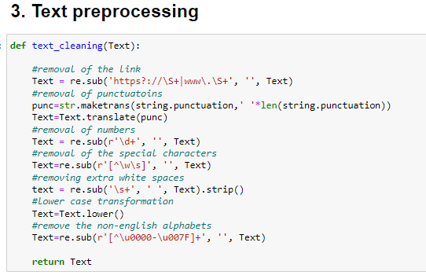

Slide 7
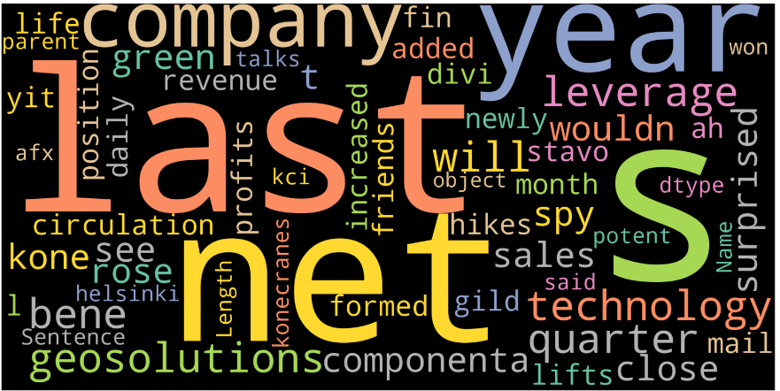
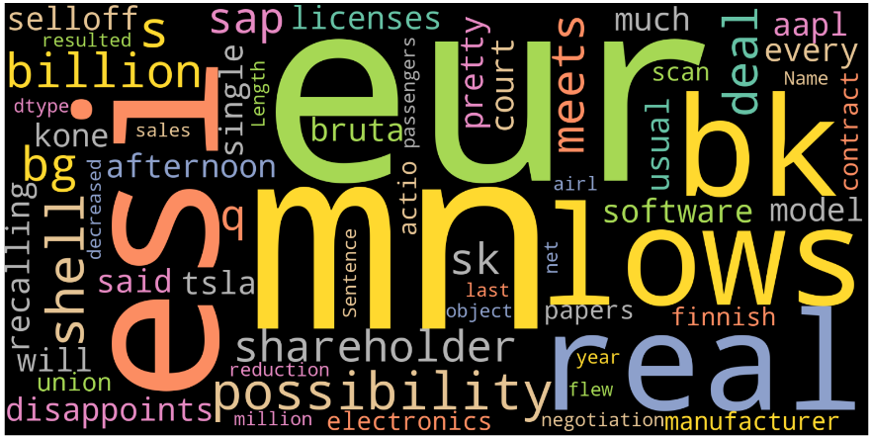
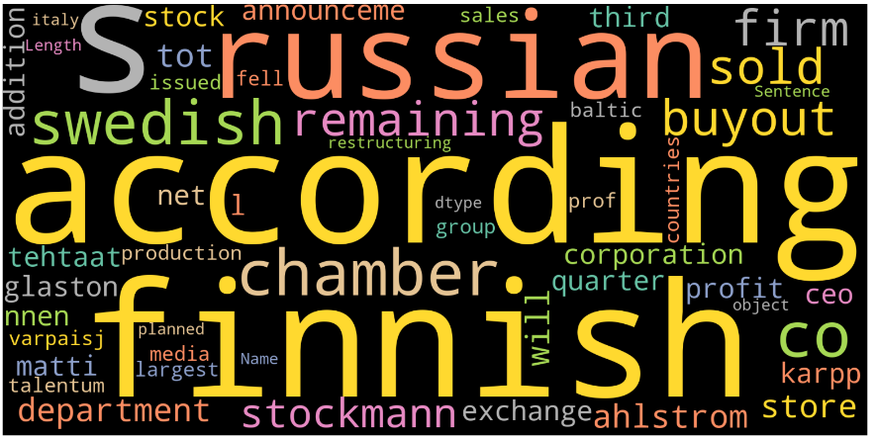
WordCloud for three Category
Positive
Negative
Neutral
We can see from three wordcloud that the
Three dataset has some common words that words are domain specific and not make any contribution towards sentiment

Slide 8
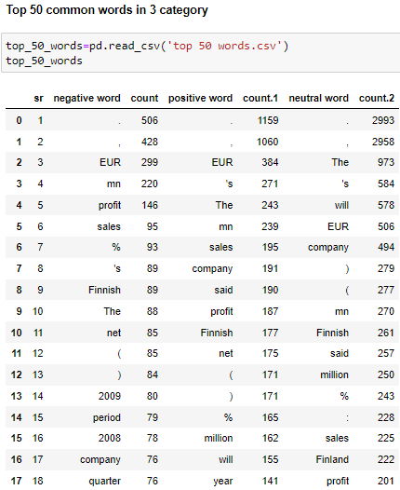
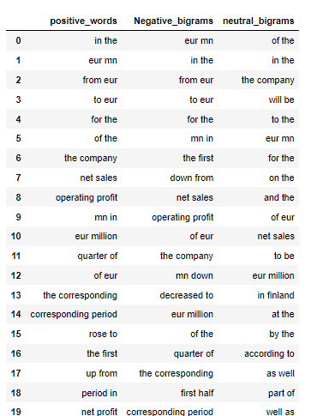
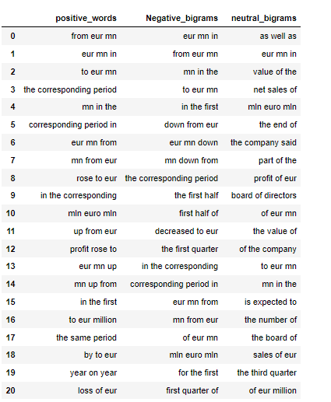
Top 50 words that are common in three category
By looking at the unigram most of the words are common in thee category also the stop words are present
Before removing the common words and stop words we plot bigram to check impact on polarity.it is observed that the some bigrams are common that we will remove from data

Slide 9
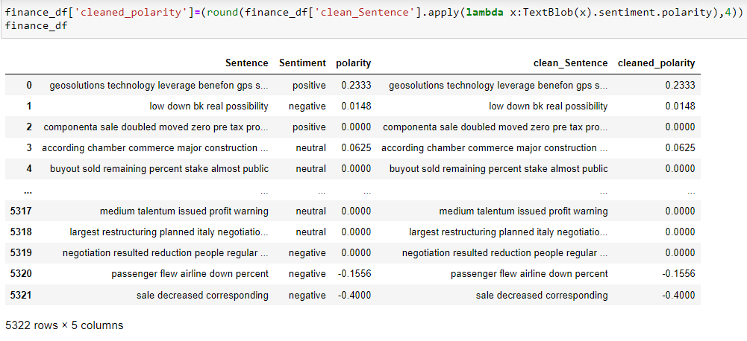
Comparing the polarity score on cleaned data and without cleaned Data.

Slide 10
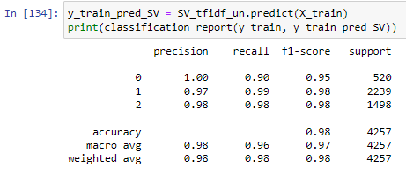
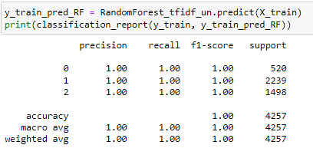
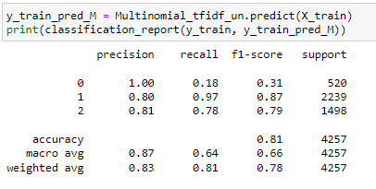
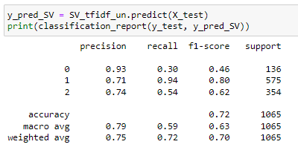
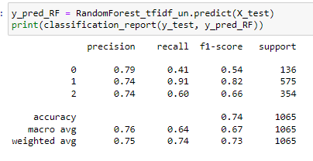
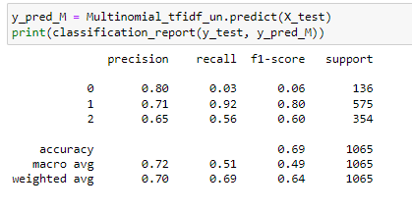
1.Tf-idf
Support Vector Machine
Random Forest Classifier
Multinomial navie bayes

Slide 11
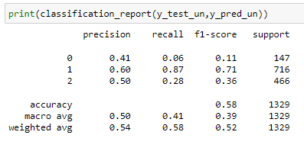
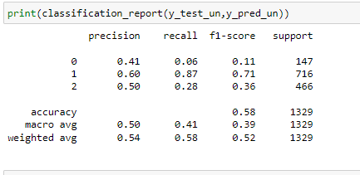
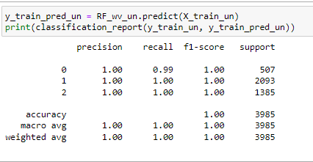
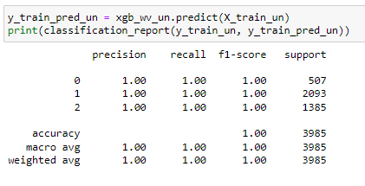
Word2Vec
Random Forest Classifier
XGBM

Slide 12

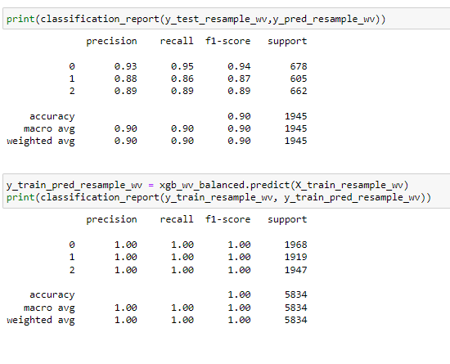
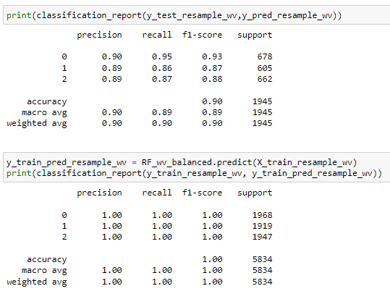
Word2Vec
Random Forest Classifier
XGBM

Slide 13
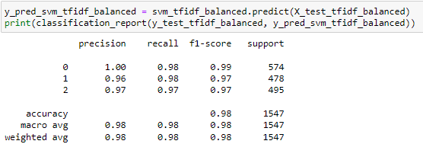
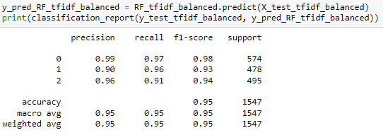
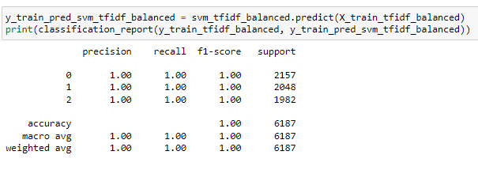
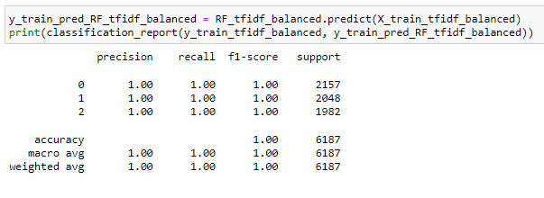
Word2Vec
SVM_Tfidf
RF_tfidf

Slide 14
Model Summery
Model name | Claassifier | Train Accuracy | Test Accuracy
1.Tf-idf | Support Vector Machine | 98 | 72
 | Random Forest Classifier | 100 | 74
 | Multinomial navie bayes | 81 | 69
2.Word2Vec | Random Forest Classifier | 100 | 58
 | XGBM | 100 | 58
3.Word2Vec ( Balancing data SMOTEEN) | Random Forest Classifier | 100 | 90
 | XGBM | 100 | 90
 | SVM_Tfidf | 100 | 98
 | RF_tfidf | 100 | 95

Slide 15
Conclusion:
Without balancing data we can see that the model work well in trainig but work poor in test data
After balancing the data by SMOTEEN accuracy of model improved in testing data as well.
From all model Word2Vec model with SVM_TFIDF and Random_forest_TFIDF work well hence we are selecting the SVM_TFIDF model for deployment

Slide 16
Model Deployment Using Streamlit and GitHub
Please find attached link of Model Deployment:
https://mohitemao-financial-sentiment-analysi-sentiment-analysis-tmtu6a.streamlit.app

Slide 17
Thank You

